Slide 1


https://blog.wish.com
Summer sales insights: performance analytics and strategic decisions for Wish.com

Slide 2

Table Of Contents
1
7
Ratings and price
factor analysis
Dataset overview
2
Generated variables
& dataset modifications
Ratings and units
sold analysis
8
3
9
Impact of Ad Boosts on sales
General statistics
4
Product’s color and size analysis
10
Merchant performance insights
5
Top performing tags in
sales and units sold
Shipping options on sales impact
11
6
Best and worst performing tags in user ratings
Banner & urgency status on sales impact
12

Slide 3
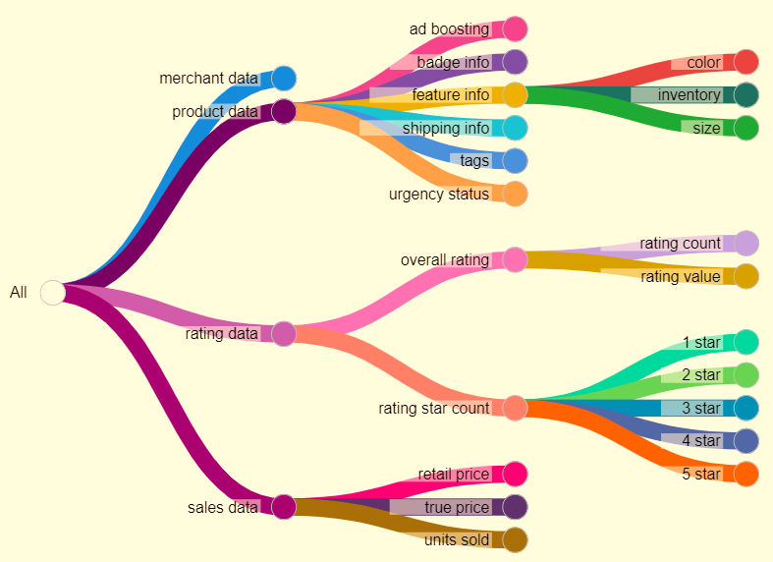
01
Dataset overview
This dataset provides a thorough description of various items sold in EU region during a particular summer. There are four main data categories: merchant info, product, sales and rating data.
The interconnectedness of each product features, such as badge information, urgency status, tags, and ad boosting offers many dimensions to online selling where advertising, merchant reputation and marketing strategies greatly influence sales performance.
Understanding correlations and patterns, such as how shipping information and rating data relate to sales figures, can help us determine the success of a product and its related components.

Slide 4
02
Generated variables & dataset modifications
Generated table and variables
The column “revenue” is generated via the formula “price” x “units_sold”
5 columns of “percent_rating_<N star>” are created by the formula “rating_<N star>_count” / “rating_count”. Star rating percent is better than rating count to avoid rating count difference between best and least selling products.
A new table of “tags_statistics” are created, each row containing a unique tag used in the summer product data. For each tag, average N star rating percent, average units sold, average revenues are then calculated across all products that contains the tag in the summer products’ column “tags”. Tags are crucial in finding top selling and rated products.
Dataset modifications
The “index”, “crawl_month”, “product_picture”, “product_url”, “merchant_profile_picture” columns are dropped since they are not relevant to the analysis, unless there is powerful scraping methods for these data.
“currency_buyer” and “theme” columns are deleted for having only 1 value. Additionally, “shipping_option_name”, “urgency_text”, “origin_country” are also removed from analysis as most products have the same value.
All Boolean columns such “uses_ad_boosts” and “badge_local_product” are turned into True/False datatype.
“merchant name” and “merchant title” are nearly similar. Additionally, since there are no merchants of different id that have the same title, the merchant title is unique. The columns “merchant_id” and “merchant_name” are thus removed.

Slide 5
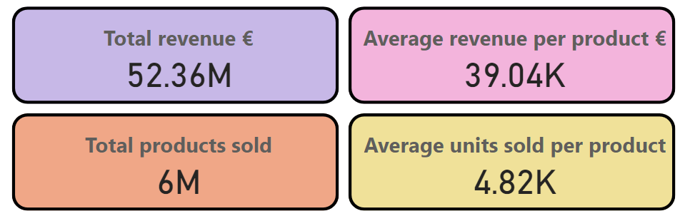

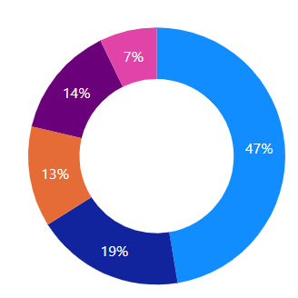
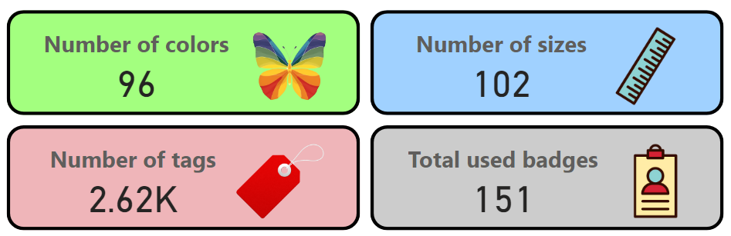
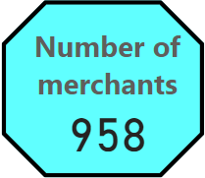
03
General statistics
Generally, the merchants on wish.com have performed exceptionally well in summer sales, as seen by the high revenue coupled with majority of positive ratings (47% of all ratings is 5 stars and 19% of all ratings is 4 stars)

Slide 6
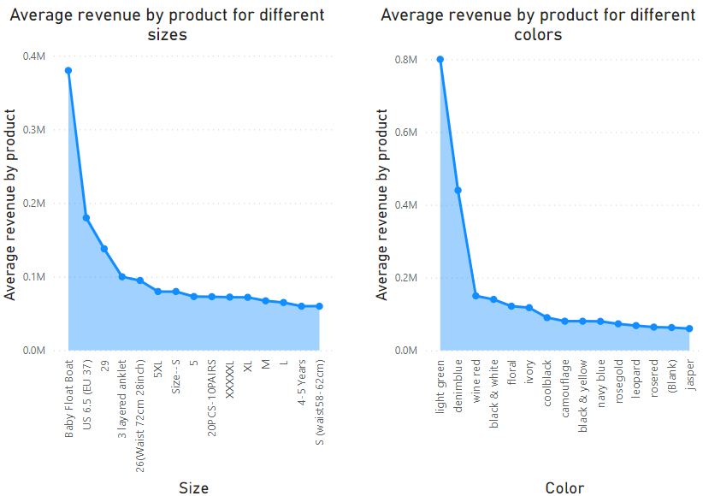
04
Product’s color and size analysis
💡 INSIGHT: The data shows that a very small subset of sizes and colors are generating significantly higher average revenue than the others, with the “baby float boat”, “US 6.5 (EU 37), “29” size and “light green”, “denim blue”, and “wine red” colors standing out as top earners.
✊ ACTION:
The context of the selling period is important to determine these sizes and colors. For example, summer apparels and items tend to sell well then they have vibrant colors (especially green and red hues) as the ones shown.
Sizes are harder to determine, so Wish.com should collect sizes of items sold in other seasons to determine the size’s trend

Slide 7
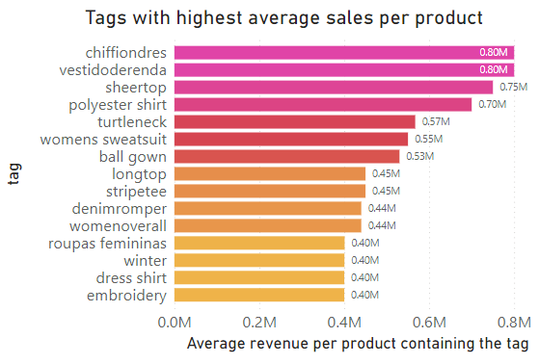
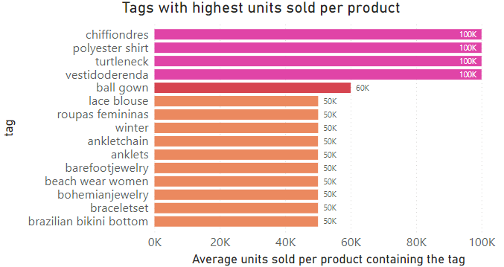
05
Top performing tags in sales and units sold
💡 INSIGHT: Products tagged with "chiffon dresses“, "polyester shirt" and “vestidoderenda” (lace dress), not only sell the highest volume but also generate the most revenue per product, indicating a strong market preference for these apparels.
Additionally, top selling and rated products are highly female oriented, such as women, ball gown and anklets tags.
✊ ACTION: Focus on stock optimization and marketing for dresses, anklets, gowns, polyester shirts, female oriented items, and consider expanding the range within these high-performing categories to capitalize on their popularity.

Slide 8
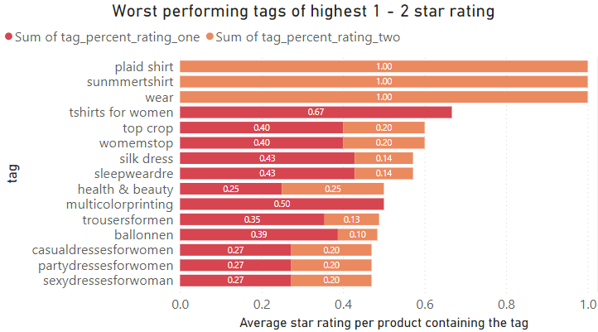
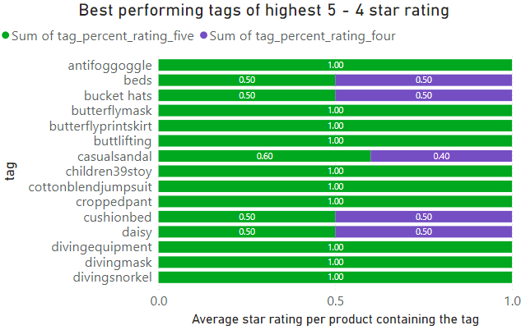
06
Best and worst performing tags in user ratings
💡 INSIGHT: Tags such as "antifog goggle" and "diving equipment" are the best performers in terms of user satisfaction, indicating a successful match between product quality and customer expectations. Conversely, tags like "plaid shirt" and "summer shirt" are showing poorer performance in customer ratings, especially dresses for womens, despite it was shown earlier that women items are top sellers. This could be due to incorrect size, colors not matching advertisements, etc
✊ ACTION: Investigate the customer feedback (ratings and comments) for low-performing tags to identify the root causes of dissatisfaction, ensuring that product descriptions and images exactly match those that customers receive

Slide 9
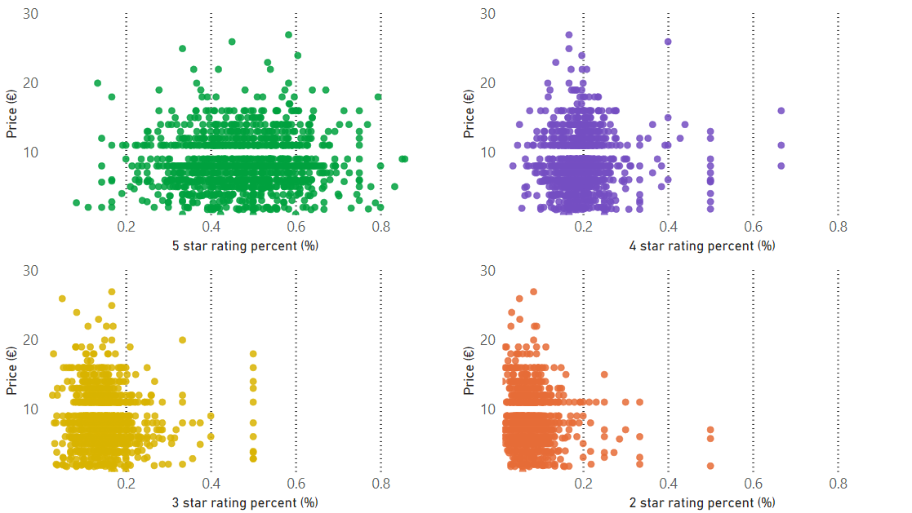
07
Ratings and price factor analysis
💡 INSIGHT: 5 star ratings tends to be equally distributed across all price ranges. However, lower star ratings tend to be more conservative, whose range is around 0-40%
✊ ACTION: Consider pricing strategies that match customer quality perception, such as raising prices for high-rated items to increase the value and product profit margins. Additionally, evaluate the cost-benefit of improving or discontinuing lower-rated, lower-priced items to keep brand reputation

Slide 10
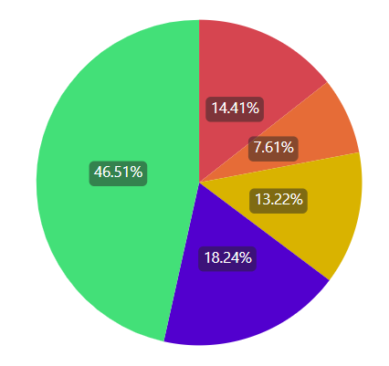
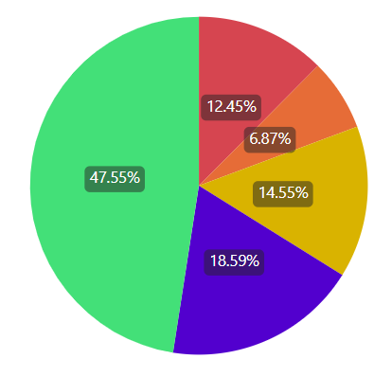
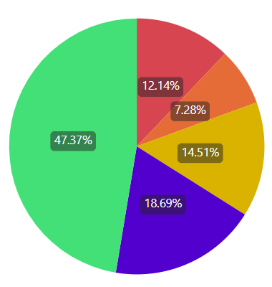
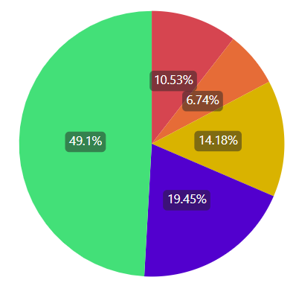
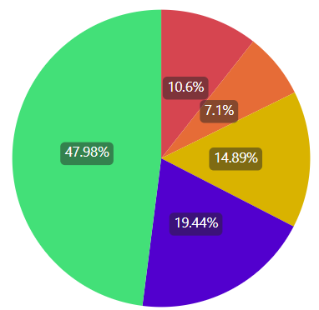
08
Ratings and units sold analysis
The products are divided into 5 groups by a range of units being sold
For each group of categorized products by units sold, we can estimate the average percent of star ratings, ranging from 1 star to 5 star rating.
It appears that the distribution of percent of star rating is similar across all units sold.
However, on average, the percent of 4 and 5 star ratings become slightly higher if the products are sold more often ⇒ 💡 INSIGHT: existing good ratings of a product can indeed boost its sales performance
1 – 100
units sold
101 – 1000
units sold
1001-5000
units sold
5001 – 10000
units sold
10001 – 100000
units sold

Slide 11
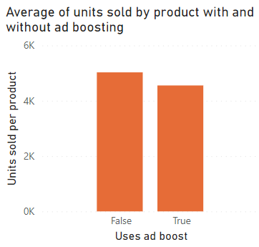
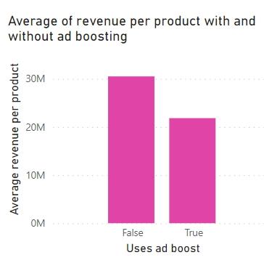
09
Impact of Ad Boosts on sales
It appears that products using ad boosting actually have lower average units sold and revenue as compared to those without ad boosting. This can be surprising, but there are two possible explanations
Products that rely heavily on ad boosts might have less appeal or weaker product-market fit compared to others that sell well without additional advertising.
The online shopping market can be saturated with similar ads about summer products, potential customers might experience ad fatigue. This lead to diminishing returns on further advertising
⇒ ✊ ACTION: It is okay for products to not use ad boosting at all, which could help cut advertising costs.

Slide 12
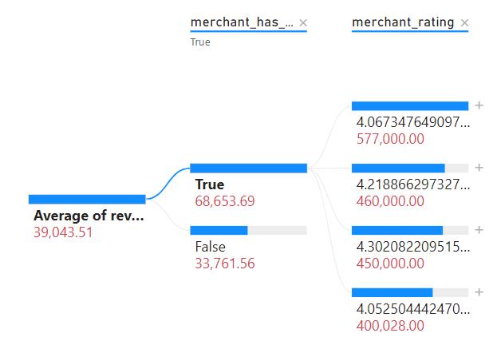
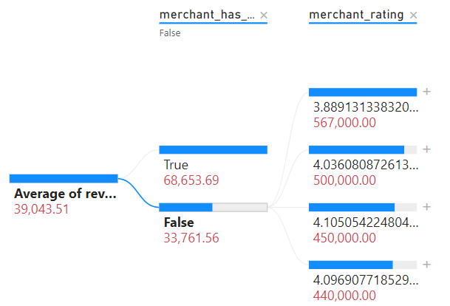
10
Merchant performance insights
Top merchants rating (black) with profile picture and their revenue (red)
Top merchants rating (black) with profile picture and their revenue (red)
Merchants having profile picture or not, with average revenue (red)
Merchants having profile picture or not, with average revenue (red)
Average revenue
Average revenue
💡 INSIGHT: Merchants with profile pictures have significantly higher average revenues compared to those without, indicating that a profile picture may influence customer trust and purchasing decisions. The top-performing merchants, particularly those with the highest revenues, tend to have higher ratings as well.
✊ ACTION: Encourage all merchants to add profile pictures to their accounts to increase their revenue and customer product ratings. Wish.com can request to interview the top earners with highest ratings and profile pictures to identify other common factors that could be driving their high revenues and recommend their practices to other merchants.

Slide 13
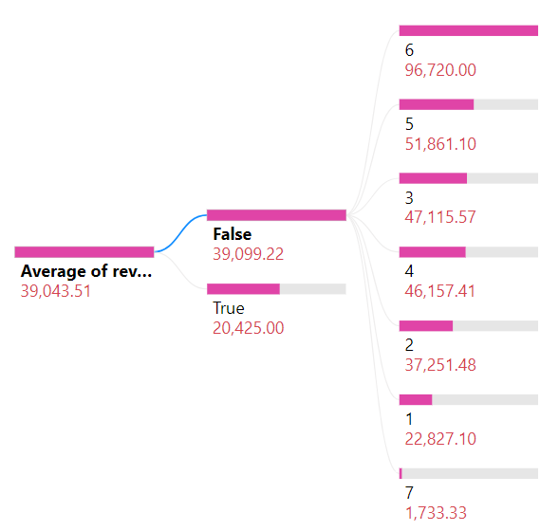
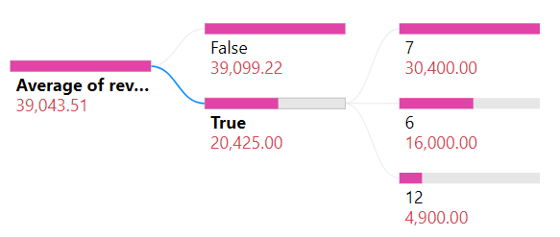
11
Shipping options on sales impact
💡 INSIGHT: Merchants offering express shipping have a lower average revenue than those who do not, suggesting that customers may not prioritize speed over cost. However, the highest shipping prices correlate with the highest revenues, indicating that customers may be willing to pay more for premium shipping options.
Shipping price
Shipping is express
Shipping is express
Shipping price
Average revenue
Average revenue
✊ ACTION: Review the pricing strategy for express shipping and consider bundling express shipping with high-value products. Additionally, Wish.com can survey customer preferences to understand the demand for tiered shipping prices based on the urgency and value of the product.

Slide 14
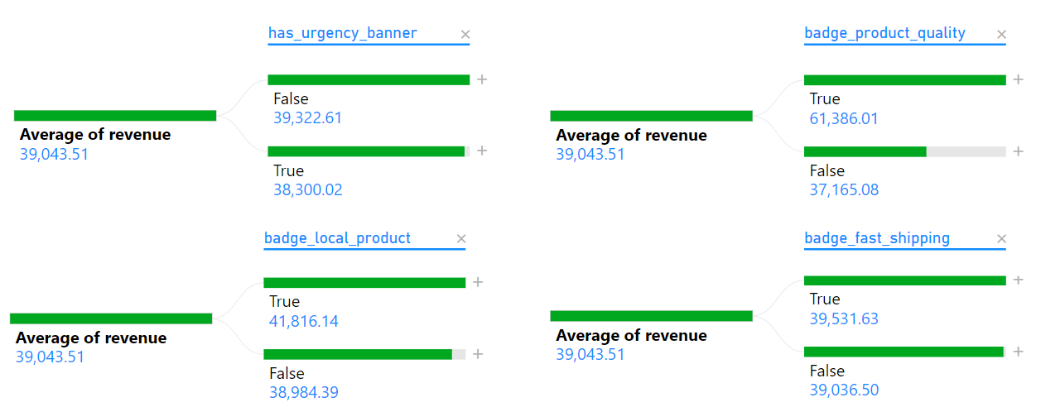
12
Banner & urgency status on sales impact
💡 INSIGHT:
Products with a quality badge see a significant increase in average revenue, as customers is likely to associate the badge with higher-quality products and willing to pay more.
Moreover, products featuring the badge for local product tend to generate slightly higher revenue than those that don’t. This could mean customers may prefer to support local businesses or perceive local products as higher quality.
The urgency status and fast shipping have no impact on revenues. This could be that customers do not care about a product’s urgency if they do not really need them.
✊ ACTION: Wish.com should prioritize recommending local products to increase visibility and boost sales. Additionally, what criteria the products must have to be qualified for the quality badge should be standardized to maintain trust in merchants and platform reputation

Slide 15

Conclusions
Purpose Recap: This report analyzed seasonal sales data to uncover patterns in consumer buying behavior and product performance on Wish.com shop website
Key Insights:
High-quality and local product badges significantly increase product revenue.
Express shipping does not necessarily lead to higher revenue, but premium shipping options do
Customer preferences for product features (color, size, tags) can greatly impact sales.
Recommended Actions:
Find all product categories with highest performing tags to analyze their features. Prioritize keeping in stock these products when summers arrive.
Increase visibility of products with quality and local badges to build consumer trust and quality perception. Standardizing quality badge is crucial
Collect customer feedback and their product ratings to continuously improve product offerings and marketing strategies.

